Slide 1
Development of Computer Vision based AI Tools for Out-of-Bound Detection in Dementia Care Home
T4 Group 3
Angel (221993P), Ying Jing (224416M),
Derrek (222356K), YouYan (221191L)

Slide 2
TABLE OF CONTENTS
01
02
03
04
05
06
07
08
09
Introduction
Setup
Feature 2:
Loitering &
Boundary Detection
Feature 3:
Alert System
Feature 1: Human Detection
Feature 5:
Azure Blob Storage
Feature 4:
Real-time Low Light Enhancement
Limitations & Future Enhancement
Live Demo
+
Q&A

Slide 3
01
INTRODUCTION
5
Brief Intro on Problem Statement & Objectives
Notes:
Brief introduction here

Slide 4
PROBLEM STATEMENT
“Residents of Apex Harmony Lodge (AHL) face the challenge of unintentionally wandering beyond predesignated safe boundaries within the care home premises. This behavior poses significant risks to their safety and well-being, including exposure to potential hazards.”

Slide 5
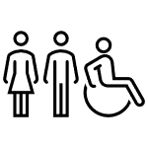


OBJECTIVES
Elevate residents and family satisfaction
Enhance Resident safety
Enhance care quantity
Respond quickly to AHL residents who stray outside of approved zones to avoid any potential dangers.
Enhance living experience with a safe environment for residents and families, promoting peace of mind and satisfaction.
Creating a secure, encouraging atmosphere that fosters independence and well-being is essential to addressing Singapore's aging demographic concerns.

Slide 6
02
SETUP
Software & Hardware used, Configuration

Slide 7


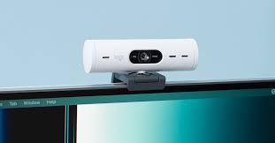

Software & Hardware used
Hardware
Software
Laptop
Jupyter notebook
Web Cam
Microsoft Azure Blob Storage

Slide 8







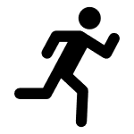
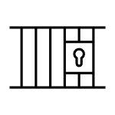
Configuration
Step1. Connect laptop to wifi
Step2. Connect USB webcam to laptop
Step3. Download jupyterlab/anaconda to use jupyter notebook
Step4. Upload folder [EGT217_T4_Grp3_Project] into jupyter notebook
Step5. Refer to instructions.txt file to make custom changes to the codes
Step6. Run all the cells
Notes:
- objective is to establish a seamless connection between laptops and the CCTV system, enabling efficient access and real-time monitoring of residents' behaviors by caregivers to enhance overall safety and responsiveness.

Slide 9
03
HUMAN DETECTION
What, How, Why

Slide 10
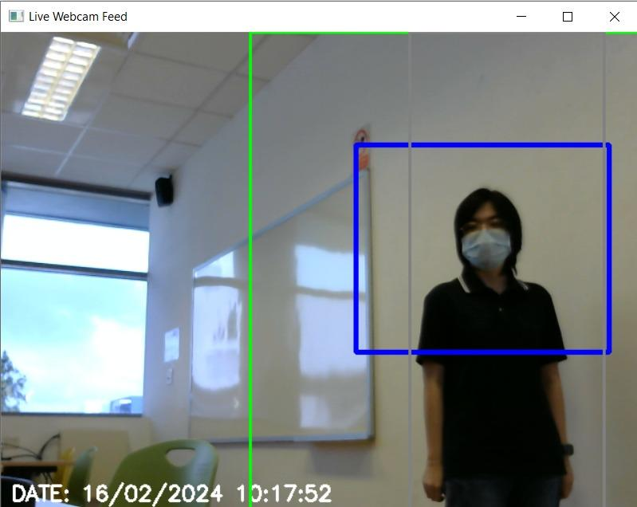
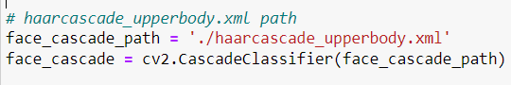
Feature 1: Human Detection
What: Monitor the movements of humans specifically. It detects and tracks people to ensure they do not wander into unsafe or unauthorized areas, known as "out of bounds" zones.
How:
Haar Cascade Classifier: The code employs OpenCV's Haar cascade classifier pre-trained on half body to detect human presence in the webcam feed.
Why:
-Safety: To enhance the safety of dementia patients who may wander off without awareness of their environment.
-Automated monitoring: No constant physical supervision is needed, staff’s workload is reduced (helpful especially when they are busy)
Notes:
This is the full code so far: import cv2
import pygame
import numpy as np
import time
import datetime
def adjust_gamma(image, gamma=1.0):
inv_gamma = 1.0 / gamma
table = np.array([((i / 255.0) ** inv_gamma) * 255
for i in np.arange(0, 256)]).astype("uint8")
return cv2.LUT(image, table)
def adjust_brightness(image, brightness):
return cv2.convertScaleAbs(image, alpha=1.0, beta=brightness)
def check_person_status(person_id, person_bbox, current_time):
x, y, w, h = person_bbox
person_center = (int(x + w / 2), int(y + h / 2))
left_of_grey_area_x_start = boundary_zone[0]
left_of_grey_area_x_end = buffer_zone[0]
in_left_of_grey_area = (left_of_grey_area_x_start < person_center[0] < left_of_grey_area_x_end)
if person_id not in persons:
persons[person_id] = {
'start_time': current_time,
'in_left_of_grey_area': in_left_of_grey_area,
'loitering': False,
'out_of_boundary': False,
'last_time_out_of_boundary': None
}
else:
person_record = persons[person_id]
if in_left_of_grey_area:
if not person_record['in_left_of_grey_area']:
person_record['start_time'] = current_time
elif current_time - person_record['start_time'] > 5:
pygame.mixer.Sound.play(alert_sound)
person_record['in_left_of_grey_area'] = True
else:
person_record['in_left_of_grey_area'] = False
boundary_polygon = np.array([
[boundary_zone[0], boundary_zone[1]],
[boundary_zone[0] + boundary_zone[2], boundary_zone[1]],
[boundary_zone[0] + boundary_zone[2], boundary_zone[1] + boundary_zone[3]],
[boundary_zone[0], boundary_zone[1] + boundary_zone[3]]
], dtype=np.int32)
buffer_polygon = np.array([
[buffer_zone[0], buffer_zone[1]],
[buffer_zone[0] + buffer_zone[2], buffer_zone[1]],
[buffer_zone[0] + buffer_zone[2], buffer_zone[1] + buffer_zone[3]],
[buffer_zone[0], buffer_zone[1] + buffer_zone[3]]
], dtype=np.int32)
inside_boundary = cv2.pointPolygonTest(boundary_polygon, person_center, False) >= 0
inside_buffer = cv2.pointPolygonTest(buffer_polygon, person_center, False) >= 0
if person_id not in persons:
persons[person_id] = {
'start_time': current_time,
'loitering': False,
'out_of_boundary': not inside_boundary,
'last_time_out_of_boundary': None
}
else:
if not inside_boundary:
persons[person_id]['out_of_boundary'] = True
persons[person_id]['last_time_out_of_boundary'] = current_time
else:
persons[person_id]['out_of_boundary'] = False
persons[person_id]['last_time_out_of_boundary'] = None
in_left_of_grey_area = person_center[0] > boundary_zone_x and person_center[0] < buffer_zone_x
return in_left_of_grey_area
def is_night_time(start_hour, start_minute, end_hour, end_minute):
current_datetime = datetime.datetime.now()
start_time = datetime.datetime(current_datetime.year, current_datetime.month, current_datetime.day, start_hour, start_minute)
end_time = datetime.datetime(current_datetime.year, current_datetime.month, current_datetime.day, end_hour, end_minute)
return start_time <= current_datetime <= end_time or (end_time < start_time and not (end_time < current_datetime < start_time))
# Initialize Pygame for alert
pygame.init()
alert_sound = pygame.mixer.Sound('buzzer.wav')
# Flag to indicate whether the code block should be executed
# execute_code = False
# Initialize the webcam
cap = cv2.VideoCapture(1)
print("Webcam opened:", cap.isOpened())
#./haarcascade_frontalface_default.xml
# haarcascade_frontalface_default.xml path
face_cascade_path = './haarcascade_frontalface_default.xml'
face_cascade = cv2.CascadeClassifier(face_cascade_path)
boundary_zone = [150, 100, 300, 220]
buffer_zone = [boundary_zone[0] + 10, boundary_zone[1] + 10, boundary_zone[2] - 20, boundary_zone[3] - 20]
loitering_threshold = 5 # 5 sec
persons = {}
while True:
ret, frame = cap.read()
if not ret:
break
# Set the time range for night time (e.g., 10pm to 7:00am)
night_range_start_hour = 22
night_range_start_minute = 0
night_range_end_hour = 7
night_range_end_minute = 0
# Flag to indicate whether the code block should be executed
execute_code = is_night_time(night_range_start_hour, night_range_start_minute, night_range_end_hour, night_range_end_minute)
if execute_code:
current_time = time.time()
current_datetime = datetime.datetime.now()
formatted_datetime = current_datetime.strftime("DATE: %d/%m/%Y %H:%M:%S")
cv2.putText(frame, formatted_datetime, (10, frame.shape[0] - 10), cv2.FONT_HERSHEY_SIMPLEX, 0.7, (255, 255, 255), 2)
height, width = frame.shape[:2]
expansion_width = 70
boundary_zone_width = (width // 2) + expansion_width
boundary_zone_height = height
boundary_zone_x = (width // 2) - expansion_width
boundary_zone_y = 0
buffer_zone_width = boundary_zone_width // 2
buffer_zone_height = boundary_zone_height
buffer_zone_x = boundary_zone_x + buffer_zone_width - expansion_width // 2
buffer_zone_y = boundary_zone_y
boundary_zone = [boundary_zone_x, boundary_zone_y, boundary_zone_width, boundary_zone_height]
buffer_zone = [buffer_zone_x, buffer_zone_y, buffer_zone_width, buffer_zone_height]
boundary_polygon = np.array([
[boundary_zone[0], boundary_zone[1]],
[boundary_zone[0] + boundary_zone[2], boundary_zone[1]],
[boundary_zone[0] + boundary_zone[2], boundary_zone[1] + boundary_zone[3]],
[boundary_zone[0], boundary_zone[1] + boundary_zone[3]]
], np.int32)
buffer_polygon = np.array([
[buffer_zone[0], buffer_zone[1]],
[buffer_zone[0] + buffer_zone[2], buffer_zone[1]],
[buffer_zone[0] + buffer_zone[2], buffer_zone[1] + buffer_zone[3]],
[buffer_zone[0], buffer_zone[1] + buffer_zone[3]]
], np.int32)
gray = cv2.cvtColor(frame, cv2.COLOR_BGR2GRAY)
faces = face_cascade.detectMultiScale(image=gray, scaleFactor=1.05, minNeighbors=6, minSize=(20, 20))
current_time = time.time()
any_out_of_boundary = False
boundary_color = (0, 255, 0)
for (x, y, w, h) in faces:
person_id = (x, y, w, h)
check_person_status(person_id, (x, y, w, h), current_time)
person = persons[person_id]
if person['out_of_boundary']:
box_color = (0, 0, 255)
boundary_color = (0, 0, 255)
if person['last_time_out_of_boundary'] and (current_time - person['last_time_out_of_boundary']) < 1:
pygame.mixer.Sound.play(alert_sound)
elif person['loitering']:
box_color = (0, 165, 255)
if current_time - person['start_time'] >= loitering_threshold:
pygame.mixer.Sound.play(alert_sound)
else:
box_color = (255, 0, 0)
person['loitering'] = False # Reset loitering status
cv2.rectangle(frame, (x, y), (x + w, y + h), box_color, 3)
cv2.polylines(frame, [boundary_polygon], True, (0, 255, 0), 2)
cv2.polylines(frame, [buffer_polygon], True, (128, 128, 128), 2)
gray_frame = cv2.cvtColor(frame, cv2.COLOR_BGR2GRAY)
gamma_corrected_frame = adjust_gamma(gray_frame, gamma=1.0)
brightened_frame = adjust_brightness(gamma_corrected_frame, brightness=30)
cv2.imshow('Live Webcam Feed', brightened_frame)
if cv2.waitKey(1) & 0xFF == ord('q'):
break
else:
current_datetime = datetime.datetime.now()
formatted_datetime = current_datetime.strftime("DATE: %d/%m/%Y %H:%M:%S")
cv2.putText(frame, formatted_datetime, (10, frame.shape[0] - 10), cv2.FONT_HERSHEY_SIMPLEX, 0.7, (255, 255, 255), 2)
height, width = frame.shape[:2]
expansion_width = 70
boundary_zone_width = (width // 2) + expansion_width
boundary_zone_height = height
boundary_zone_x = (width // 2) - expansion_width
boundary_zone_y = 0
buffer_zone_width = boundary_zone_width // 2
buffer_zone_height = boundary_zone_height
buffer_zone_x = boundary_zone_x + buffer_zone_width - expansion_width // 2
buffer_zone_y = boundary_zone_y
boundary_zone = [boundary_zone_x, boundary_zone_y, boundary_zone_width, boundary_zone_height]
buffer_zone = [buffer_zone_x, buffer_zone_y, buffer_zone_width, buffer_zone_height]
boundary_polygon = np.array([
[boundary_zone[0], boundary_zone[1]],
[boundary_zone[0] + boundary_zone[2], boundary_zone[1]],
[boundary_zone[0] + boundary_zone[2], boundary_zone[1] + boundary_zone[3]],
[boundary_zone[0], boundary_zone[1] + boundary_zone[3]]
], np.int32)
buffer_polygon = np.array([
[buffer_zone[0], buffer_zone[1]],
[buffer_zone[0] + buffer_zone[2], buffer_zone[1]],
[buffer_zone[0] + buffer_zone[2], buffer_zone[1] + buffer_zone[3]],
[buffer_zone[0], buffer_zone[1] + buffer_zone[3]]
], np.int32)
gray = cv2.cvtColor(frame, cv2.COLOR_BGR2GRAY)
faces = face_cascade.detectMultiScale(image=gray, scaleFactor=1.1, minNeighbors=6, minSize=(30, 30))
current_time = time.time()
any_out_of_boundary = False
boundary_color = (0, 255, 0)
for (x, y, w, h) in faces:
person_id = (x, y, w, h)
check_person_status(person_id, (x, y, w, h), current_time)
person = persons[person_id]
if person['out_of_boundary']:
box_color = (0, 0, 255)
boundary_color = (0, 0, 255)
if person['last_time_out_of_boundary'] and (current_time - person['last_time_out_of_boundary']) < 1:
pygame.mixer.Sound.play(alert_sound)
elif person['loitering']:
box_color = (0, 165, 255)
if current_time - person['start_time'] >= loitering_threshold:
pygame.mixer.Sound.play(alert_sound)
else:
box_color = (255, 0, 0)
person['loitering'] = False # Reset loitering status
cv2.rectangle(frame, (x, y), (x + w, y + h), box_color, 3)
cv2.polylines(frame, [boundary_polygon], True, (0, 255, 0), 2)
cv2.polylines(frame, [buffer_polygon], True, (128, 128, 128), 2)
cv2.imshow('Live Webcam Feed', frame)
if cv2.waitKey(1) & 0xFF == ord('q'):
break
cap.release()
cv2.destroyAllWindows()
pygame.quit()

Slide 11
04
LOITERING & BOUNDARY DETECTION
What, How, Why

Slide 12
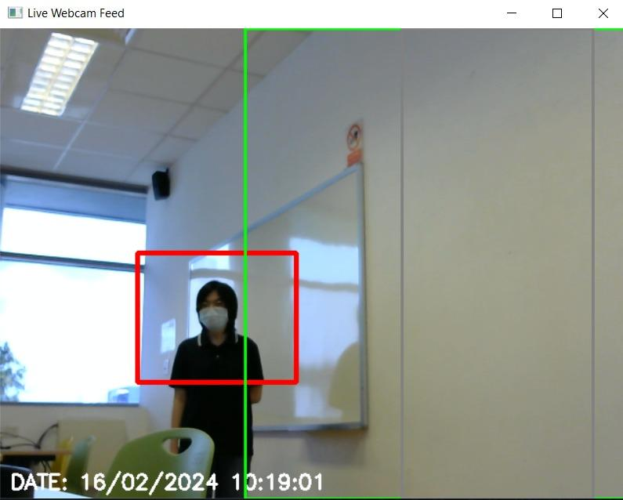
Feature 2: Loitering & Boundary Detection
What:
-Defines safe zone area, out-of-bound area
- Detects and monitors how long a patient is loitering near the exit door/restricted area.
- Duration of loitering will be calculated to trigger further actions if they are there for an extended period of time or if they went out of bound (boundary zone box will turn red visually too)
Notes:
What:
-Defines safe zone area, out-of-bound area
- Detects and monitors how long a patient is loitering near the exit door/restricted area.
- Duration of loitering will be calculated to trigger further actions if they are there for an extended period of time or if they went out of bound (boundary zone box will turn red visually too)

Slide 13
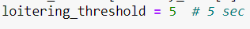
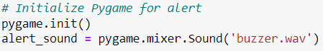
Continuation from last slide
How:
- Coordinates(x,y) are used to define both boundary zones:
-Green boundary zone
-Grey boundary zone
- Time stamp used to track time and calculate duration to determine if the alarm should be triggered
- Pygame Mixer function used to activate alarm
Why:
-Enhanced Security Measures: Boundary setting acts as a digital fence, setting clear parameters within which individuals can move freely. This increases security power and prevents potential intrusions.
-Early Warning System: By identifying individuals with abnormal behavior (loitering near out-of-bound areas), it allows for timely interventions before any actual breach occurs.
Notes:
How:
- Coordinates(x,y) are used to define both boundary zones:
-Green boundary zone
-Grey boundary zone
- Time stamp used to track time and calculate duration to determine if the alarm should be triggered
- Pygame Mixer function used to activate alarm
Why:
-Enhanced Security Measures: Boundary setting acts as a digital fence, setting clear parameters within which individuals can move freely. This increases security power and prevents potential intrusions.
-Early Warning System: By identifying individuals with abnormal behavior (loitering near out-of-bound areas), it allows for timely interventions before any actual breach occurs.

Slide 14
05
ALERT SYSTEM
What, How, Why

Slide 15
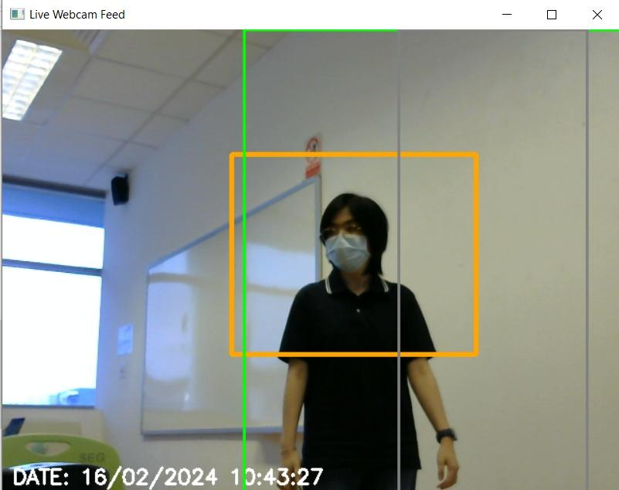
Feature 3: Alert System
What:
-When patients is out of bound the alarm will be triggered, patients will be boxed up in red for easier tracking
-Signs of loitering near out-of-bound area will trigger alarm, patients will be boxed up in orange for easier tracking
Notes:
What:
-When patients is out of bound the alarm will be triggered, patients will be boxed up in red for easier tracking
-Signs of loitering near out-of-bound area will trigger alarm, patients will be boxed up in orange for easier tracking

Slide 16

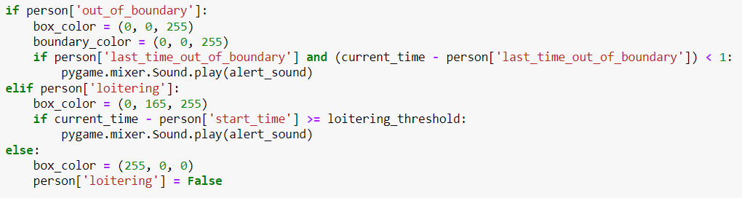
Continuation from last slide
How:
Uploaded ‘buzzer.wav’ (alarm) file into jupyter notebook
Use Pygame Mixer function used to activate alarm
Why:
-Immediate attention: Audio alert enables quicker response time for staff to react, this prevent potential incidents from occurring
-Error Reduction in visually cluttered places: Chance of error is high when staff are fatigued or if the environment is visually cluttered, thus automated alert system will be very helpful in this situation
Notes:
How:
Uploaded ‘buzzer.wav’ (alarm) file into jupyter notebook
Use Pygame Mixer function used to activate alarm
Why:
-Immediate attention: Audio alert enables quicker response time for staff to react, this prevent potential incidents from occurring
-Error Reduction in visually cluttered places: Chance of error is high when staff are fatigued or if the environment is visually cluttered, thus automated alert system will be very helpful in this situation

Slide 17
06
REAL-TIME LOW LIGHT ENHANCEMENT
What, How, Why

Slide 18
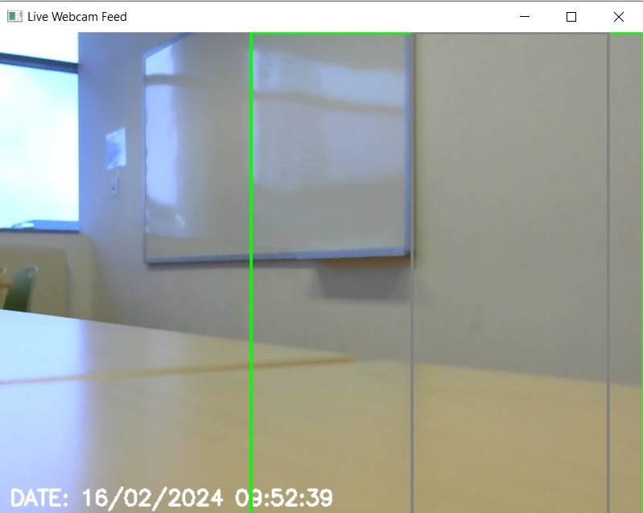
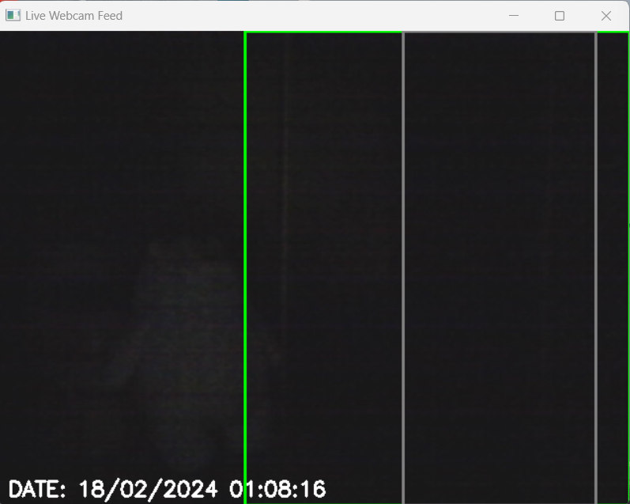
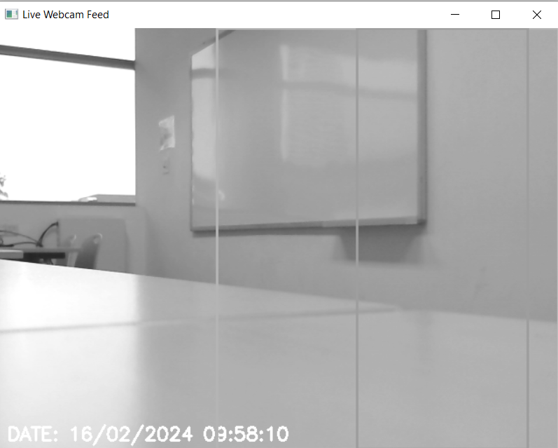
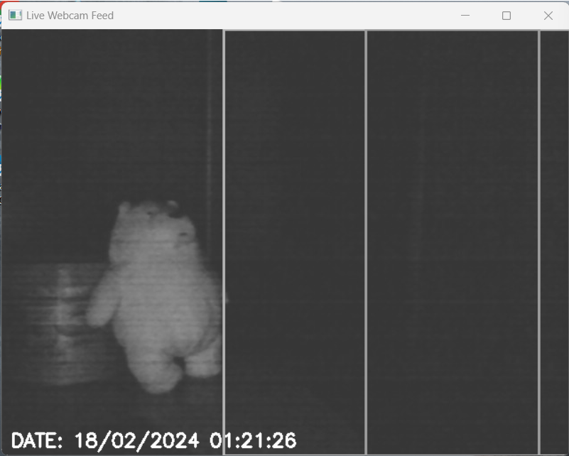
Feature 4: Real-time Low Light Enhancement
Original
What:
- Monitor residents’ behaviors for both indoors and outdoors.
- Able to detect resident’s movement whether its day time or night time with varying lighting condition
Enhanced
Notes:
Additional Info
Low Light Enhancement monitor the residents’ behaviors for both indoors and outdoors. This include if they are engaged in specific activities, moving in certain patterns, or exhibiting unusual behaviors. It aims to improve the visibility of the scene captured by the CCTV in low-light conditions, allowing for better detection and analysis of the residents’ behavior.
The feature was utilized using traditional image preprocessing techniques such as Gamma Correction and Brightness Correction to improve the visibility and quality of footages captured in low-light conditions. In the context of low light enhancement, gamma correction is applied to adjust the brightness and contrast of the video. By modifying the gamma value, it enhances the visibility of details in darker areas while preserving the overall video quality. On the other hand, Brightness correction techniques are applied to increase the overall brightness of the video, making it easier to see the details and improve visibility. (Especially in the dark environment)
Low light enhancement is applied to the video feed within specified time ranges, where it switches on and off accordingly. For instance, outdoor areas have low light enhancement activated from 8pm to 7am, while indoor areas have it activated from 10pm to 6am. During unspecified times, no low light enhancement is applied. This scheduling ensures that indoor and outdoor areas remain adequately illuminated during the night. Clear footage is captured for caregivers to review any abnormalities in resident behavior during unsupervised loitering times.
This feature was selected for several reasons. Low light enhancement plays a crucial role in enhancing visibility, ensuring that residents' movements and actions are clearly captured by CCTV cameras in low-light conditions. This aids in effectively monitoring their activities. Additionally, low light enhancement facilitates monitoring of frame feed changes during specified time ranges, enabling real-time observation of residents' behaviors. This allows caregivers to promptly address any identified potential risks or accidents, ensuring the safety and well-being of residents at all times. Furthermore, low light enhancement contributes to providing higher quality care to residents by leveraging their behavior patterns, enabling timely responses to emergencies, and overall improving support for residents' well-being.

Slide 19
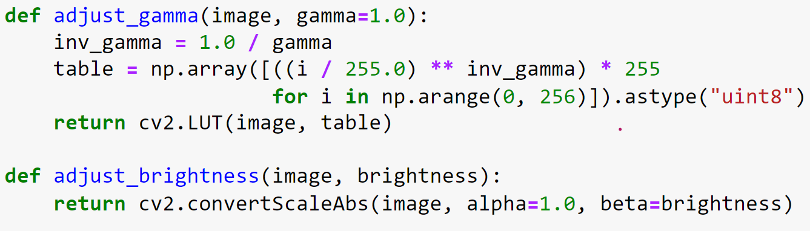
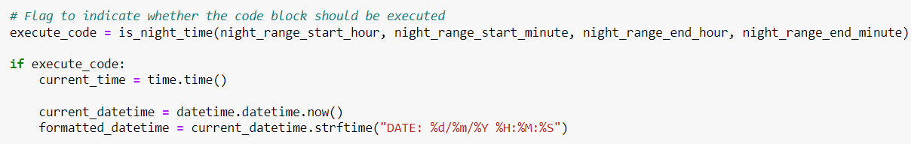
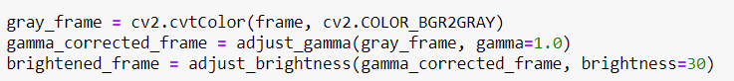
Continuation from last slide
How:
- Utilizes traditional image preprocessing techniques such as Gamma Correction and Brightness Correction.
- Frame feed changes during specified time range.
Why:
Enhanced Visibility: Ensures that movements/actions of the residents are captured clearly.
Safety and Security: Identify any potential risks or dangerous situations to take appropriate actions for prevention.
Quality of Care: Personalized care based on residents’ behavior.

Slide 20
07
AZURE BLOB STORAGE
What, How, Why

Slide 21
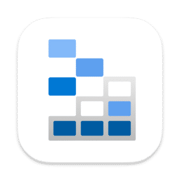
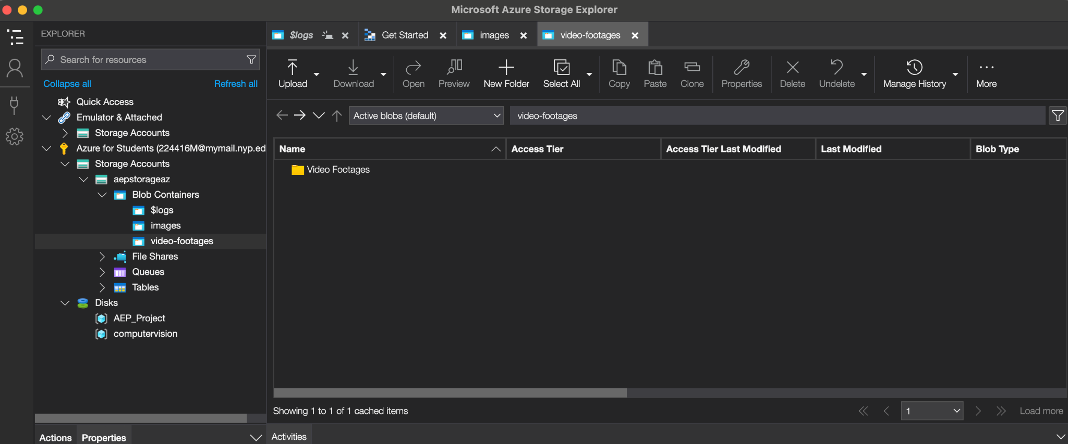
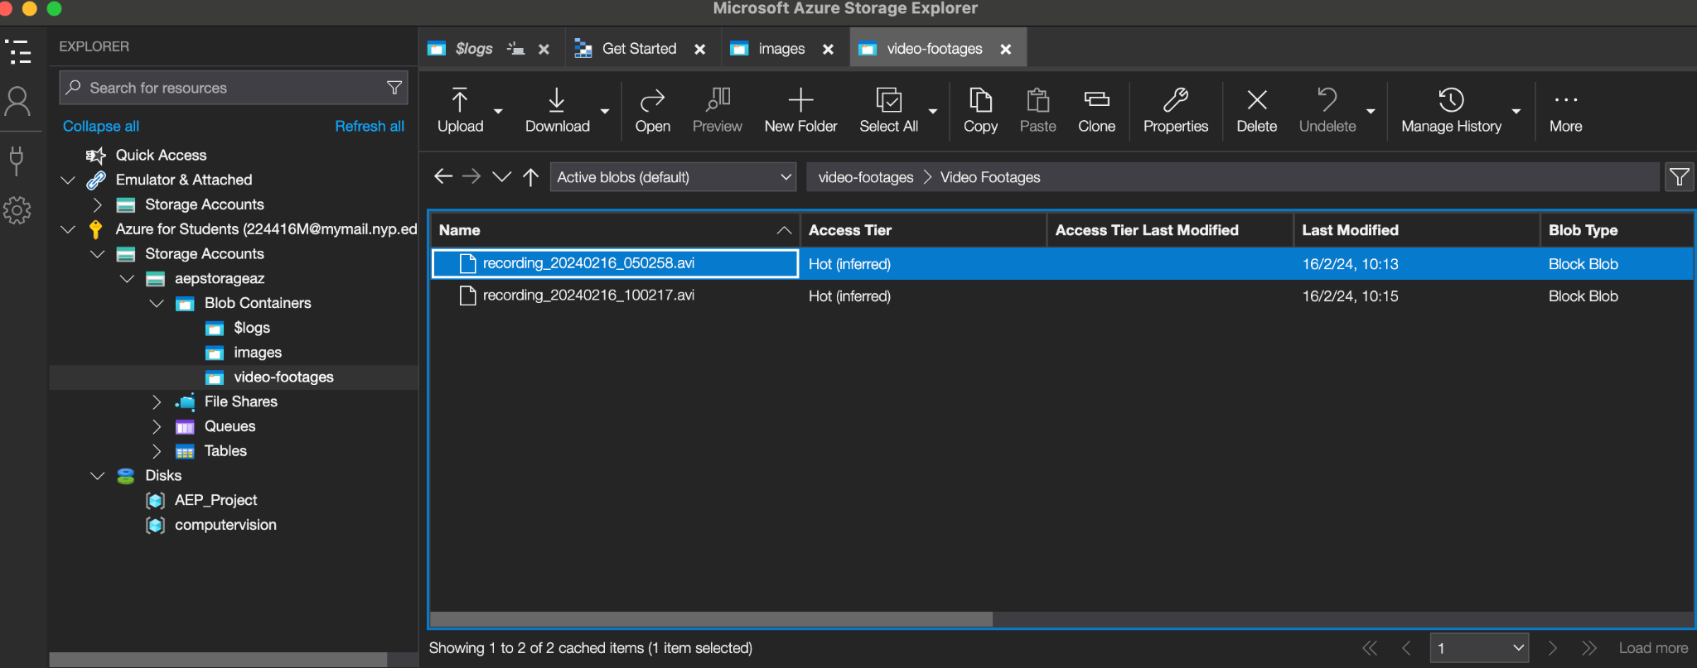
Feature 5: Azure Blob Storage
What:
- Serves as a cloud based storage.
- Store large amounts of unstructured data of various file
types and extensions in the cloud.
How:
- Create Azure Resource Group and Storage Account Service.
- Link created Resource Group to Storage Account Service.
- Navigate to container section to add a container (folder).
- Upload CCTV footages into the container created.
- View created storage accounts, containers, and container files with Azure Storage Explorer
Why:
Media Storage - Store recorded CCTV footages obtained for media streaming / content delivery purposes.
Data Backup & Archiving - Store backups of critical data/archival data for long-term retention.
Disaster Recovery: Disaster Recovery strategy to replicate data to secondary region for redundancy and failover purposes.
Notes:
Additional Info
Azure Blob Storage serves as a cloud based storage where it allows users to store large amounts of unstructured data of various file types and extensions in the cloud. This include videos, images, musics, and many more.
To create an azure blob storage, it requires to first create an Azure AI Services in Microsoft Azure and a Storage account service where you would need to link the resource group to it. After the creation, you would need to navigate to the container section to add container which in this case is like adding a folder. The next step is to upload your CCTV footages into the container created. You can also download Microsoft Azure Storage Explorer, an application where you can view your created storage accounts, containers with files inside the folder, but you would need to sign in with your Azure account. This can help to reduce the time to navigate to Microsoft Azure to view it which requires a lot of navigation steps.
This feature was chosen because of several reasons. Azure Blob Storage provides a robust solution for media storage, allowing users to store recorded CCTV footages efficiently for media streaming or content delivery purposes, ensuring easy access and and distribution of video contents. With Azure Blob Storage, users will have the capability to securely store backups of critical data and archival data for long-term retention. This ensures that important information is readily accessible and when needed, providing a peace of mind. Azure Blob Storage also plays a crucial role in disaster recovery strategy. If the primary region of the software used to store the CCTV footages has corrupted, Azure Blob Storage came into place as a secondary region where user are still able to have a backup copy of the lost information. This redundancy and failover capability helps users to mitigate the potential risks and maintain business continuity even during unforeseen circumstances.

Slide 22
08
Limitations &
Future Enhancement
Limitations met and possible future enhancements

Slide 23
Limitations & Future Enhancement
Limitations (Hardware)
Webcam Resolution & Frame Processing ability:
Difficulty in detecting humans in large rooms (Require them to be closer to the webcam)
Inability to achieve 100% visibility at night due to technical constraints.
Constraints on using more advanced and larger models due to limitations in GPU & CPU capabilities (Results in potential lag when processing the frame feed)

Slide 24
Limitations & Future Enhancement
Enhancement #1
Higher Quality CCTV:
Night Vision (A Better Low Light Enhancement)
Ensure clear visibility in scenarios with minimal lighting (Eg. Street lights / Moonlight)
Facilitates effective monitoring of residents’ behaviors in diverse environment.

Slide 25
Limitations & Future Enhancement
Enhancement #2
Integrate with other Azure Services:
Azure Cognitive Services (Perform tasks such as image analysis, text recognition, sentiment analysis, etc. on the data stored in blob container)
Azure Functions (Allow to automate processes, data processing tasks, or react to changes in the created blob storage)
Eg. Functions will be triggered in response to blob storage events [File creates, deletions, or modifications]
Notes:
Additional Info:
Azure Functions
Real-time Response to Security Events: Immediately respond to potential security threats or unauthorized actions. For example, functions will be triggered whenever a sensitive file is created, deleted, or modified. Then they can log the event and alert the administrators about the issues or take appropriate actions.

Slide 26
CONTRIBUTION LISTS
Tasks & Responsibilities
Leader: Angel | Member: Ying Jing | Member: Derrek | Member: YouYan
Research Human Detection feature Loitering and Boundary Detection feature Alarm System feature Azure blob storage feature Slides Report Director & photographer for demo video | Research Low Light Enhancement feature Azure blob feature Slides Report Actor & Editor for demo video | Research Low Light Enhancement feature Merged codes & debug them UI in Jupyter Slides Report | Research Loitering Detection feature Slides Report Voice actor for demo video Provided mental support from overseas

Slide 27
LIVE DEMO

Slide 28
Thank You !
QnA time!

